Slide 1
Data Management for Dynamic Multimedia Analytics and Retrieval
PhD Defense
Ralph Gasser<ralph.gasser@unibas.ch> Databases and Information Systems (DBIS) Group, Department of Mathematics and Computer Science, University of Basel
Basel, 28 November 2022

Slide 2













Motivation: Multimedia is Ubiquitous
Multimedia Retrieval
Social Media Analysis
Medical Signal Analysis
Storing Large Data Collections
Images, videos, audio, 3D
Low-frequency changes
Finding Items of Interest
“Needle in the haystack”
Short-running queries
Collecting Data over Extended Time Period
Text, images, videos etc.
High-frequency changes
Generating Insights
Trends, engagement, interest
Short and long-running queries
Simulated Data Dictionary
Abstract signal data
Little to no changes
Quantifying Sample Tissue
Highly optimised application
Potentially long-running query

Slide 3
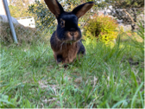


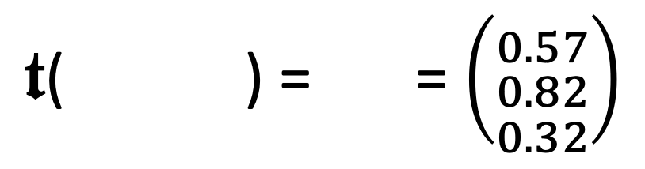
Properties of Multimedia Data
Multimedia data is often unstructured (raw signal data)
→ Disconnect between data stored and information searched → Derivative representations required
We usually make multimedia data accessible by metadata
→ Technical metadata (e.g., resolution, geo references) → Textual descriptions / labels / annotations
→ Abstract features (e.g., salient colours)
Different types of metadata can be searched differently
→ Boolean retrieval (exact matches)
→ Similarity search / vector space retrieval (fuzzy)
”grass”
”rabbit”
”bunny”
”Nutello”
$𝖙$( ) = = $\left({0.57 \atop \begin{aligned}0.82 \\ 0.32\end{aligned}}\right)$
Feature transformation
$$𝕆→ 𝔽$$

Slide 4
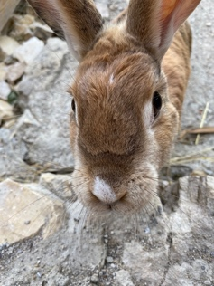
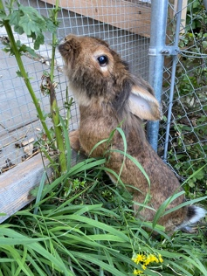
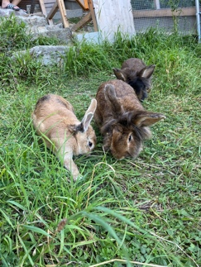
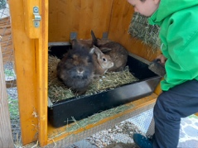
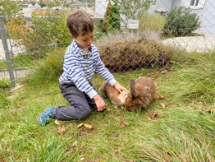
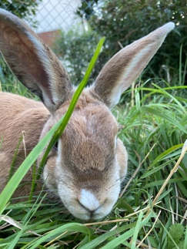
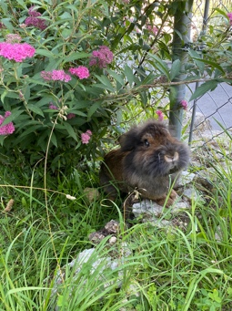
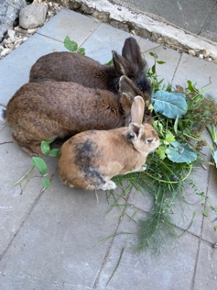

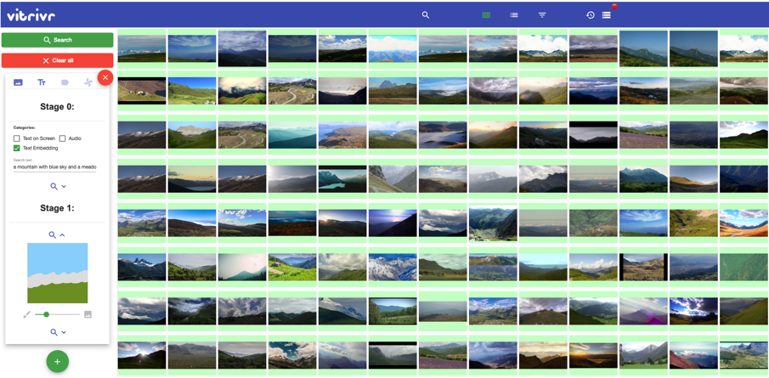
State of the Art in Multimedia Retrieval Systems
Retrieval System
Decoding
Segmentation
Feature Extraction
Data Storage
Scalar data
Feature vectors
Index structures
Metadata
Collection
offline
Multimedia Database
online
User Query
Query Interpretation Orchestration
Database Query
Query Execution
Boolean search (exact)
Similarity search (fuzzy)
Short vs. long-running
User Interface
Results
Results Fusion
Results
Rossetto et al. (2014). Cineast: a multi-feature sketch-based video retrieval engine.

Slide 5
What about more Complex Applications?
Interaction
Retrieval System
Visualization
Decoding
Segmenting
Feature transformation
Mapping
Data
Model Building
Model Visualization
Knowledge
offline
online
Transformation
Data Mining
Models
Query Interpretation
Score Fusion Orchestration
User Interface
Refinement
Seebacher et al. (2017). Visual Analytics and Similarity Search: Concepts and Challenges for Retrieval Considering Users, Tasks, and Data

Slide 6


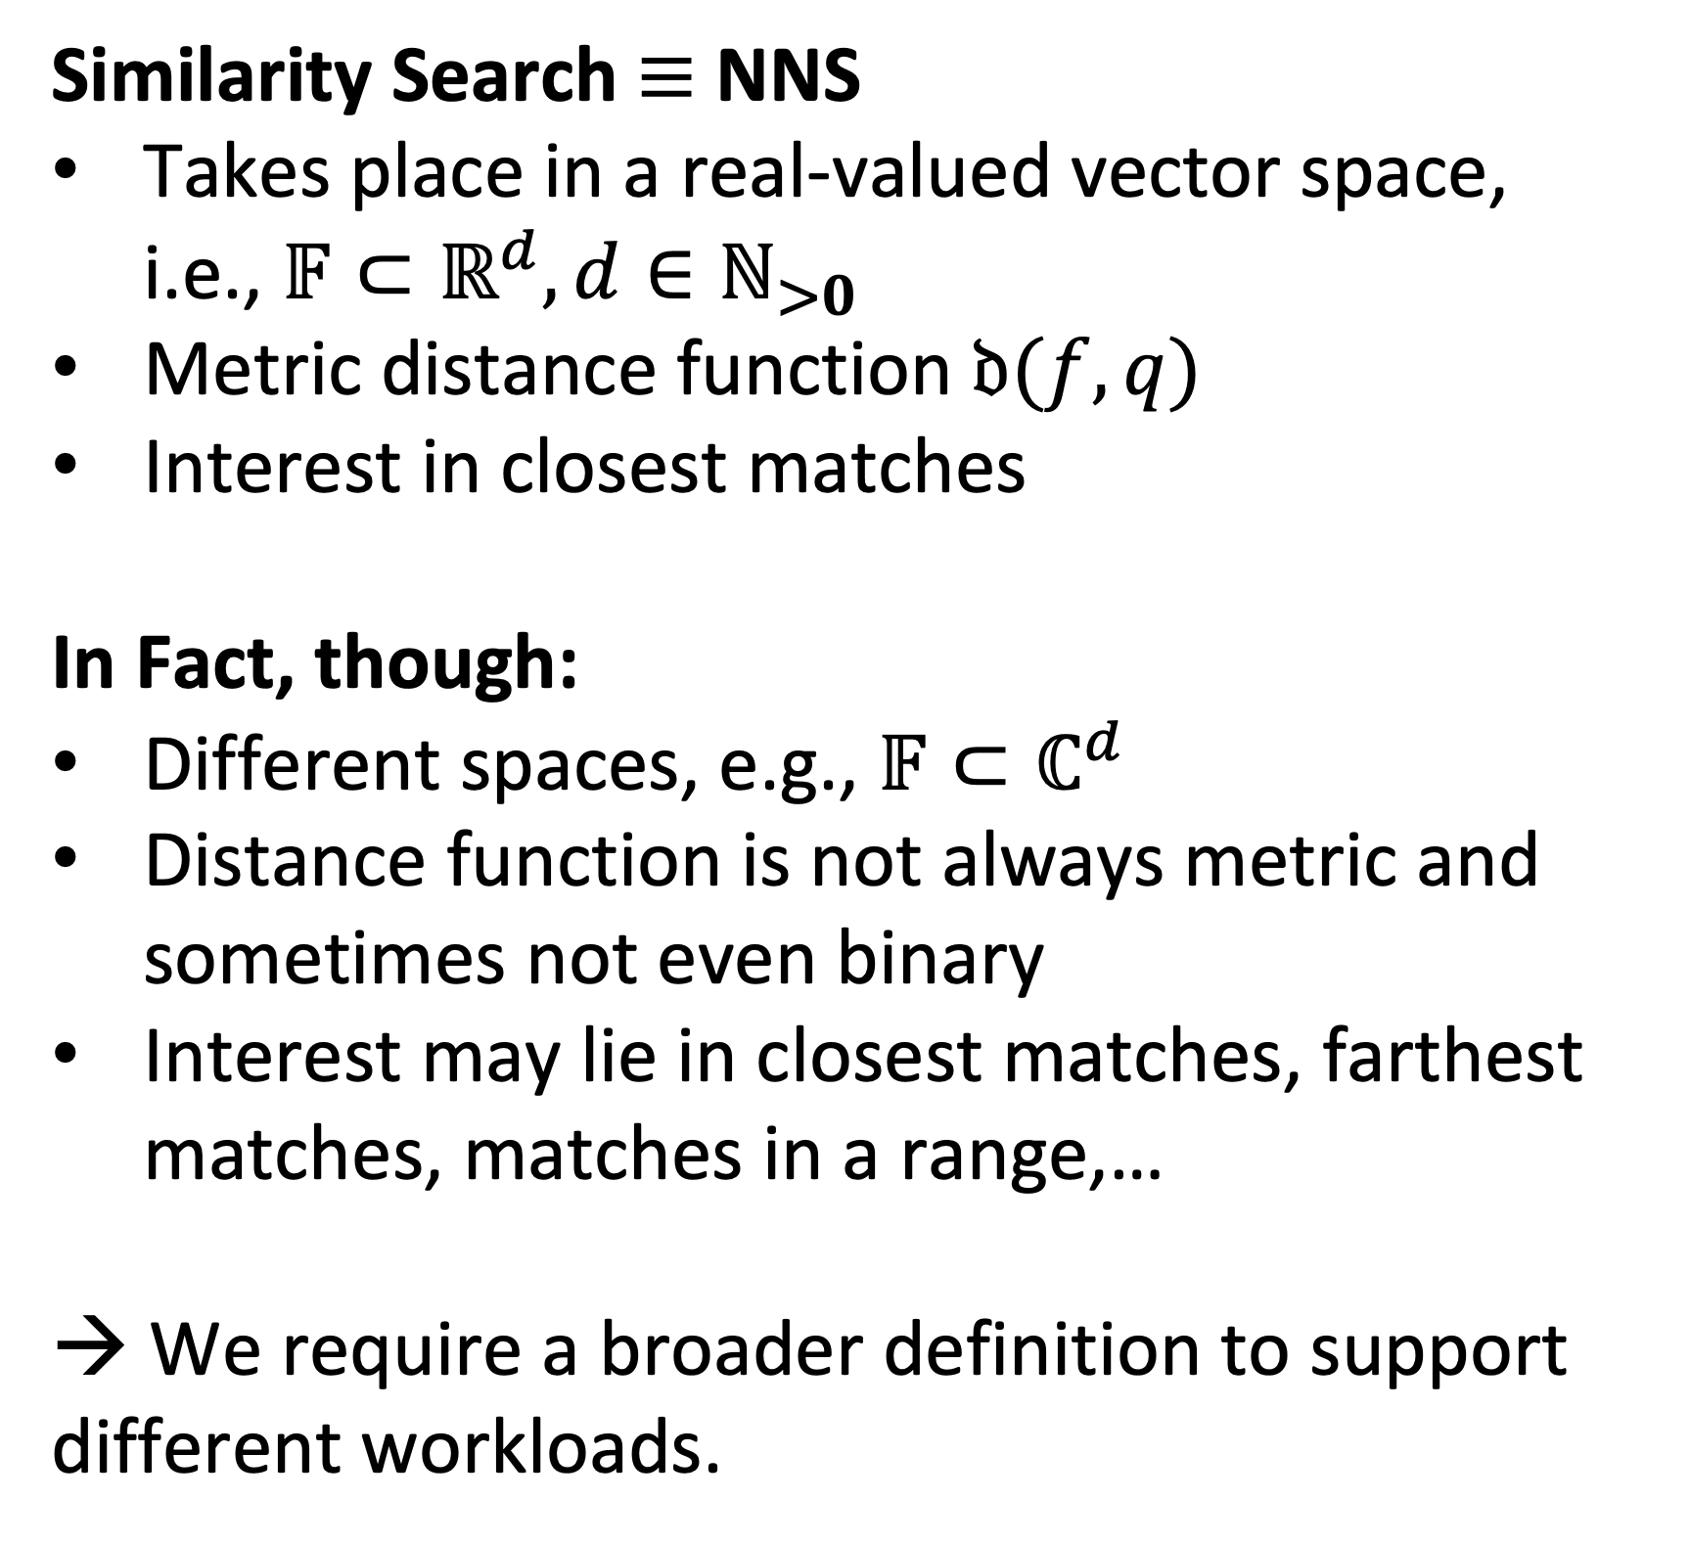

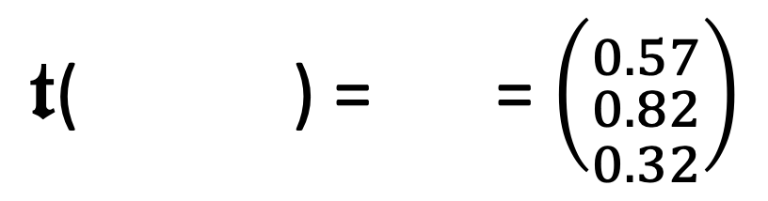
Challenging the Status Quo in Multimedia Data Management Assumption 1 / Similarity Search
Similarity Search $≡$ NNS
Takes place in a real-valued vector space, i.e., $𝔽⊂ℝ^{d}, d∈ℕ_{>0}$
Metric distance function $𝔡(f,q)$
Interest in closest matches
In Fact, though:
Different spaces, e.g., $𝔽⊂ℂ^{d}$
Distance function is not always metric and sometimes not even binary
Interest may lie in closest matches, farthest matches, matches in a range,…
→ We require a broader definition to support different workloads.
$𝖙$( ) = = $\left({0.57 \atop \begin{aligned}0.82 \\ 0.32\end{aligned}}\right)$
green
Feature transformation
$$𝕆→ 𝔽$$
$$𝔡$$
Query
red
High-dimensional Vector Space $$𝔽⊂ℝ^{3}$$
blue
Salton et al. (1975). A Vector Space Model for Automatic Indexing.

Slide 7
Challenging the Status Quo in Multimedia Data Management Assumption 2 / Staticity of Data Collections
Data Collections do not Change
Offline vs. online phase (indexing vs. search)
Index structures can be prepared
No concurrent access to data
In Fact, though:
Data may be subject to change (e.g., CRUD, social media analysis)
Write and reads to multimedia database may take place concurrently
High-Dimensional Index structures must be able to cope with (concurrent) changes
→ Incremental changes must be supported at all system levels.
Retrieval System
Feature transformation Indexing
Storage
offline
Multimedia Database
online
Query
Query Interpretation
Score Fusion Orchestration
Rossetto et al. (2014). Cineast: a multi-feature sketch-based video retrieval engine.

Slide 8
Challenging the Status Quo in Multimedia Data Management Assumption 3 / Workloads Known in Advance
Pre-determined Workloads:
System optimised for a type of workload
Only a matter of “parametrisation” (e.g., query vector, distance, index)
End-user has system-level knowledge
In Fact, though:
Query workloads may vary (see exploration search axis)
Execution paths impact results (execution time vs. retrieval quality)
Use-cases allow for different trade-offs
→ Database system must be able to plan execution of a query.
Zahàlka et al. (2014). Towards Interactive, Intelligent and Integrated Multimedia Analytics

Slide 9
Contributions of this Thesis
Conceptual
A query model that integrates proximity based queries into the relational data model with the aim to maintain the composability and to allow for query execution planning.
A cost model for query execution planning that takes the expected and desired quality of results into account, in addition to traditional metrics (e.g., IO or CPU cost)
A write- and failure model for maintaining high-dimensional index structures in the face of changing data.
Implementation
A reference implementation using the aforementioned models in the form of Cottontail DB
An evaluation showing the effectiveness of both the models and implementations

Slide 10
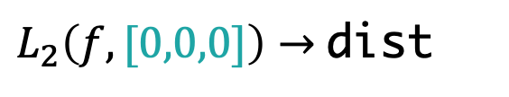
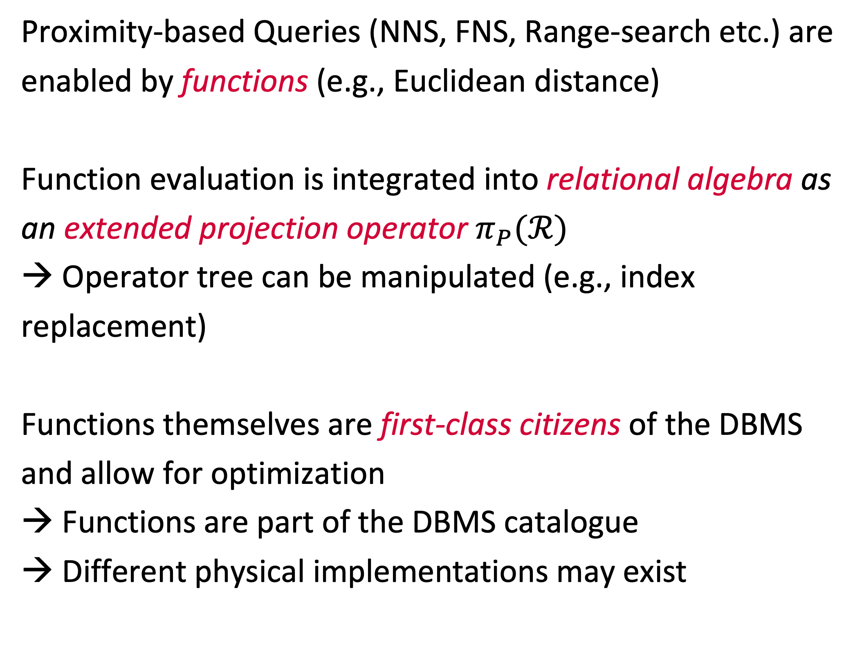
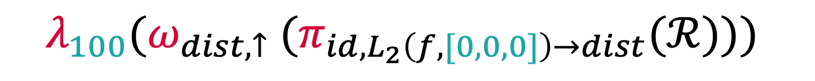
A Relational Model to Accommodate Proximity Based Queries Outline
Query
Proximity-based Queries (NNS, FNS, Range-search etc.) are enabled by functions (e.g., Euclidean distance)
Function evaluation is integrated into relational algebra as an extended projection operator $π_{P}(ℛ)$
→ Operator tree can be manipulated (e.g., index replacement)
Functions themselves are first-class citizens of the DBMS and allow for optimization
Functions are part of the DBMS catalogue
Different physical implementations may exist
select id, L2(f, [0,0,0]) as distance from paintings order by distance asc limit 100
Logical
$$λ_{100}({ω_{dist,↑} (π}_{id,L_{2}\left(f, [0,0,0]\right)→dist}(ℛ)))$$
Physical
Scan
paintings
Function
$L_{2}\left(f,[0,0,0]\right)→$dist
NNS
Order
dist ASC
Limit
100
Project
id,dist

Slide 11
A Relational Model to Accommodate Proximity Based Queries Planning and Optimisation using Indexes
Class 1
Class 2
Class 3
Scan
Scan
Scan
Function
Function
Function
Order
Order
Limit
Index ”replaces” function execution.
Example: PQ [1]
Index can replace function execution and induces order.
Example: Cached Results
Index covers a specific edge case (e.g., NNS, FNS).
Example: VAF [2]
[1] Jégou et al. (2011). Product Quantization for Nearest Neighbor Search.
[2] Weber et al. (1998). A Quantitative Analysis and Performance Study for Similarity-Search Methods in High-Dimensional Spaces.

Slide 12
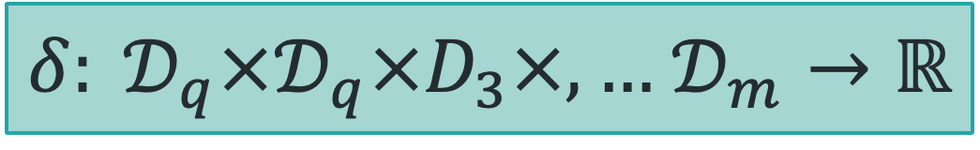


A Relational Model to Accommodate Proximity Based Queries Planning and Optimising on a Function Level
General Function
$$f:𝒟_{1}×,…,𝒟_{m}→𝒟$$
Any function known to the DBMS
(function registry).
Distance Function Class
$δ: 𝒟_{q}×𝒟_{q}×D_{3}×,…$ $𝒟_{m}→ℝ$
A distance function that can be used to
compare vectors.
Query Context
A logical implementation of a distance function (e.g., certain arguments become constants)
Logical Implementation
$$δ:𝒟_{q}→ ℝ$$
Physical Implementation
Scalar
Vectorised
GPU
A physical implementation of a distance function (e.g., executed as a SIMD optimised version)

Slide 13
A Relational Model to Accommodate Proximity Based Queries Planning and Optimising the Query
Class 1 Index Replacement
Scan[VAF]
Project
Scan
Scan
Scalar
Function
Function
Optimised Order & Limit
Vectorised
NNS
Order
Order+Limit
Limit
Project
Scan[PQ]
Project
Class 3 Index Replacement
Order
Limit
Project

Slide 14
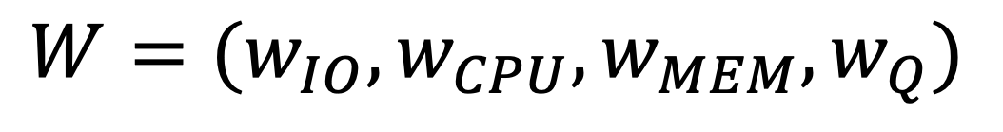
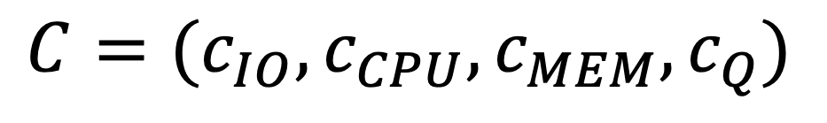
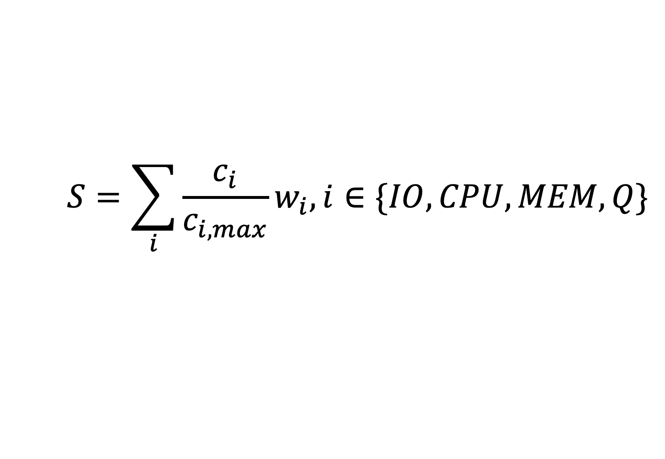
A Cost Model for Results Quality Outline
High-Dimensional Indexes often trade results quality with execution time
→ Trade-off between cost factors (CPU, IO etc.)
DBMS must be aware of this trade-off and take it into account during query planning
→ Cost model including quality
Cost policy to express user preference
Mechanism to empirically estimate ”quality cost” of using an index based on metrics such as recall or nDCG (Thesis)
Cost
$$C=(c_{IO},c_{CPU}, c_{MEM}, c_{Q})$$
Cost Policy
$$W=(w_{IO},w_{CPU}, w_{MEM}, w_{Q})$$
Cost Score
$$S=\sum_{i}{\frac{c_{i}}{c_{i,max}}w_{i}, i∈\{IO,CPU,MEM,Q\}}$$

Slide 15

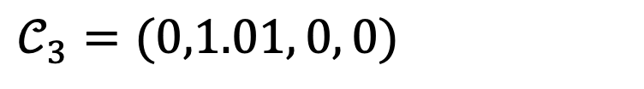

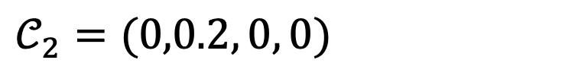
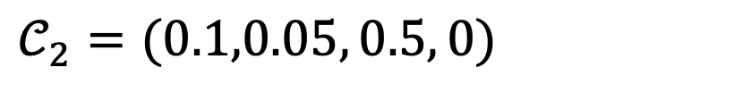


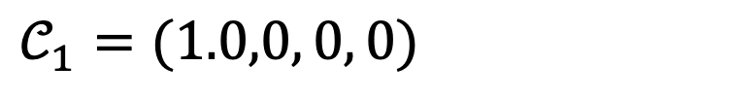

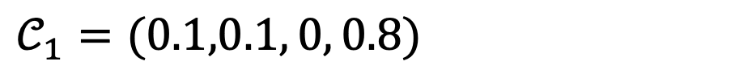

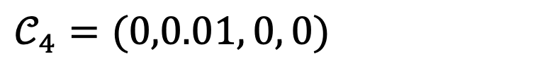
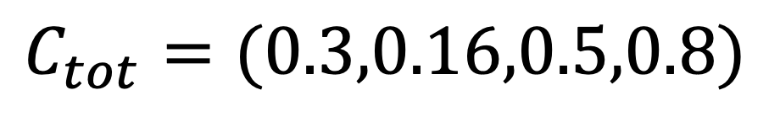
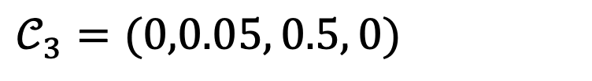
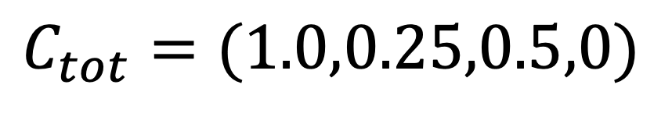
A Cost Model for Results Quality Comparing Two Execution Plans
Scan
$$𝒞_{1}=(1.0,0, 0, 0)$$
Scan[PQ]
$$𝒞_{1}=(0.1,0.1, 0, 0.8)$$
Function
$$𝒞_{2}=(0,0.2, 0, 0)$$
Order+Limit
$$𝒞_{2}=(0.1,0.05, 0.5, 0)$$
Order+Limit
$$𝒞_{3}=(0,0.05, 0.5, 0)$$
Project
$$𝒞_{3}=(0,1.01, 0, 0)$$
Project
$$𝒞_{4}=(0,0.01, 0, 0)$$
$$C_{tot}=(1.0,0.25,0.5,0)$$
$$C_{tot}=(0.3,0.16,0.5,0.8)$$
$$W=(1,0, 0,1)$$
$$W=(1,0, 0, 0)$$
$$S=1.0$$
$$S=0.3$$
$$S=1.1$$

Slide 16


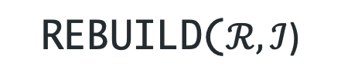

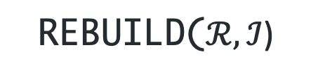
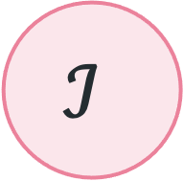

High-Dimensional Index Maintenance Outline
$$𝒞$$
Incremental changes and persistence are not systematically considered in High-Dimensional index research (with exceptions, e.g., NV-Tree [1])
To support such indexes at a system level (regardless of the index’s capability), every index must implement:
A write model for the index
A failure model for the index
An explicit state w.r.t. to its availability for a query
We also propose a non-blocking rebuild mechanism that exploits properties of snapshot isolation
$$ℐ$$
WRITEM($𝒞$)
FAILM($𝒞$)
REBUILD($ℛ,ℐ$)
CLEAN
STALE
FAILM($C$)
REBUILD($ℛ,ℐ$)
DIRTY
[1] Lejsek et al. (2008). NV-Tree: An Efficient Disk-based Index for Approximate Search in Very Large High-Dimensional Collections

Slide 17
High-Dimensional Index Maintenance Example: Write Model for a VA file [1]
$𝖙$( ) = = $\left({0.57 \atop \begin{aligned}0.82 \\ 0.32\end{aligned}}\right)$
= ?
= 22
Feature transformation
$$𝕆→ 𝔽$$
10
How does VAF work:
Partition vector space to create lattic (usually by component-wise min/max)
Assign every vector to cell in lattice
Store resulting signature
Upon scan, distance can be approximated and entry can be filtered (save CPU / IO)
Upon Insert / Update:
If point falls within grid → write signature
If point is out of bounds → issue
9
8
7
6
5
4
3
2
1
1
2
3
4
5
6
7
8
9
10
11

Slide 18
Putting Everything Together: Cottontail DB Overview
Multimedia Database
Runs on the JVM (developed in Kotlin)
Column Store
Support for Scalar and Vector data
Data Modelling (Schema, Entity)
Transaction Support
INSERT, UPDATE, DELETE
Transaction Semantics (COMMIT, ROLLBACK)
Snapshot Isolation
Similarity Queries
FUNCTION-execution, ORDER BY, LIMIT
Index Support (PQ, VA, LSH)
Vectorised Execution (experimental)
Inaccurate matches
Incremental changes
Boolean Queries
WHERE-clauses w. Boolean predicates
Index Support (B⁺-, Patricia trees)
Cottontail DB

Slide 19
Putting Everything Together: Cottontail DB Architecture
Query Model with Ext. Relational Algebra
Cost Model
Write Model
Failure Model
Async. Index Rebuild

Slide 20
Evaluation Overview
Quantitative Evaluation
Evaluation of the Query Model in a Mixed Query Workload on V3C [1]
Effect of Cost Model
Effect of Parallelism and Indexes Structures
Effect of Optimisation
The Effect of Data Changes on Yandex Deep 1B [2] (→ read- and write model)
Comparison: Milvus [3] vs. Cottontail DB on Yandex Deep 1B (→ big multimedia retrieval)
Qualitative Evaluation
Cottontail DB has been used as part of the vitrivr stack for several years now
vitrivr partook in several interactive retrieval evaluation campaigns (e.g., Video Browser Showdown [4])
[1] Rossetto et al. (2019). V3C - A Research Video Collection.
[2] Babenko et al. (2016). Efficient Indexing of Billion-scale Datasets of Deep Descriptors.
[3] Wang et al. (2021). Milvus – A Purpose-Built Vector Data Management System.
[4] Schoeffmann et al. (2019). Video Browser Showdown 2012-2019: A Review

Slide 21
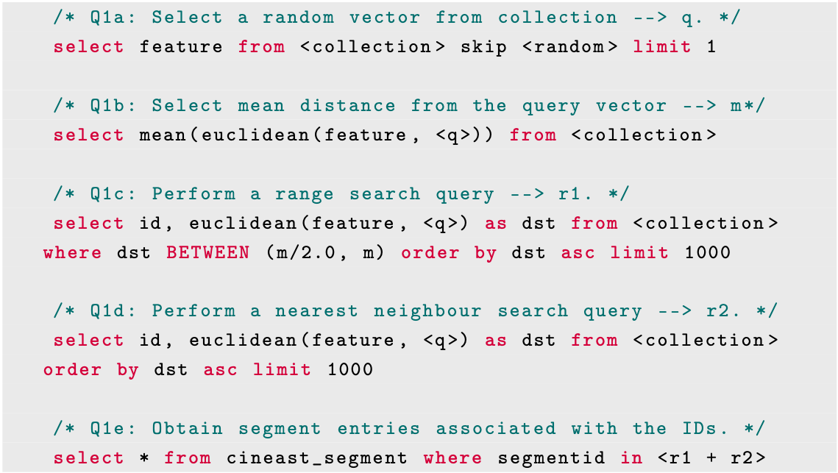
Evaluation: Query Model and the Effect of Cost Setup
Evaluation Setup
V3C [1] Dataset (different entities)
VAF & PQ-Index (pre-built) [2]
Mixed Query Workload (Q1a-Q1e)
Cost Policy set via Query Hint
→ Constant IO, CPU, Memory cost (default settings) → Increasing Quality Cost
Measurements:
Score & rank of different plan alternatives
What query plan gets selected

Slide 22
Evaluation: Query Model and the Effect of Cost Results
Proximity Based Query: select mean(L2(f, [0,0,0])) from paintings
Notes:
Available Indexes:
PQ and VAF / VAF cannot be used (class 3)
P2 vs P3 / Remove superfluous columns

Slide 23
Evaluation: Query Model and the Effect of Cost Results
Proximity Based Query: select id, L2(f, [0,0,0]) as distance from paintings order by distance asc limit 100
Notes:
Available Indexes:
PQ and VAF / VAF can be used (class 1)
P1 vs P2 / Fetch after Limit

Slide 24
Evaluation: Query Model and the Effect of Cost Discussion
Cost-based planning of proximity based queries for similarity search is feasible
Execution strategies make a difference (index vs. no-index, deferred fetching etc.)
Cost-model can be used to steer high-level behaviour of planner and express user preference
Observations:
Estimated quality provided by an index has major impact on planning process
Predicting index quality is difficult in practice depending on many different factors
Collection size & data distribution
Index parameters
Executed query

Slide 25
Evaluation: Query Model and the Effect of Cost Discussion
Nearest Neighbour Search: select id, L2(f, [0,0,0]) as distance from paintings order by distance asc limit 100
Range Search: select id, L2(f, [0,0,0]) as distance from paintings where distance between <x>,<y> order by distance

Slide 26
Evaluation: High-Dimensional Index Maintenance Setup
Evaluation Setup
Yandex Deep 1B [1] Dataset (1M shard)
VAF & PQ-Index (pre-built) [2]
NNS Queries with random vectors (→ brute-force vs. index use)
Different write workloads
Delete vs. insert ratio
Level of noise
With and without index rebuild
Measurements:
Speed-up in seconds (index vs. brute-force)
Quality in terms of recall & nDCG / (index vs. brute-force)
[1] Babenko et al. (2016). Efficient Indexing of Billion-scale Datasets of Deep Descriptors.
[2] Weber et al. (1998). A Quantitative Analysis and Performance Study for Similarity-Search Methods in High-Dimensional Spaces.

Slide 27
Evaluation: High-Dimensional Index Maintenance Results (VAF Index)
Configuration:
VAF Index [1]
Runtime 30min
90% Insert / 10% Delete
No noise
[1] Weber et al. (1998). A Quantitative Analysis and Performance Study for Similarity-Search Methods in High-Dimensional Spaces.

Slide 28
Evaluation: High-Dimensional Index Maintenance Results (VAF Index)
Configuration:
VAF index [1]
Runtime 60min
Index rebuild after 30 min
90% Insert / 10% Delete
Random noise
[1] Weber et al. (1998). A Quantitative Analysis and Performance Study for Similarity-Search Methods in High-Dimensional Spaces.

Slide 29
Evaluation: High-Dimensional Index Maintenance Discussion
Write- and failure model can be applied to VA index (similar evaluation was conducted to PQ)
Parallel index rebuild feasible without interfering with queries
Problem of time required for rebuild remains; combination with other strategies may be necessary
→ e.g., rebuilding index partition-by-partition
Observations:
Indexes (VAF [1], PQ [2]) can deal with incremental changes if data adheres to original distribution
Indexes start to deteriorate if “noisy” data accumulates, which makes index rebuild necessary
→ Relevant when index is built on non-representative sample or if use-case inherently considers data that shifts (e.g., word-embeddings on changing topics)

Slide 30
Conclusion
We have introduced three theoretical models that work towards a unified data management solution for multimedia data, usable in multimedia retrieval and analytics
Query model to express proximity based queries (NNS, FNS, Range search etc.) in relational algebra
Cost model to express approximation through indexes and quality of query results
Write- and Failure model to accommodate and maintaining high-dimensional index
The conceptual contributions have been implemented in the multimedia database Cottontail DB
Powers the vitrivr multimedia retrieval system
Battletested on many occasions in competitions such as VBS and LSC
We have presented an evaluation at a systems level on top of Cottontail DB that demonstrates the feasibility of the aforementioned models.

Slide 31
Future Work
Query Model
Integration of extended Boolean Retrieval & Fuzzy Queries (e.g., similarity joins)
Integration of different RNNS flavours
Cost Model & Planning
Automatic hyper-parameter tuning for index structures (self-adaptiveness)
Propagation of quality cost in complex query plans
Execution & Storage Model of Cottontail DB
From iterator to batch-model to leverage SIMD optimisation
Optimised storage for batch-processing (→ compression)
More index structures (graph-based, NV-Tree [1])
[1] Lejsek et al. (2008). NV-Tree: An Efficient Disk-based Index for Approximate Search in Very Large High-Dimensional Collections

Slide 32
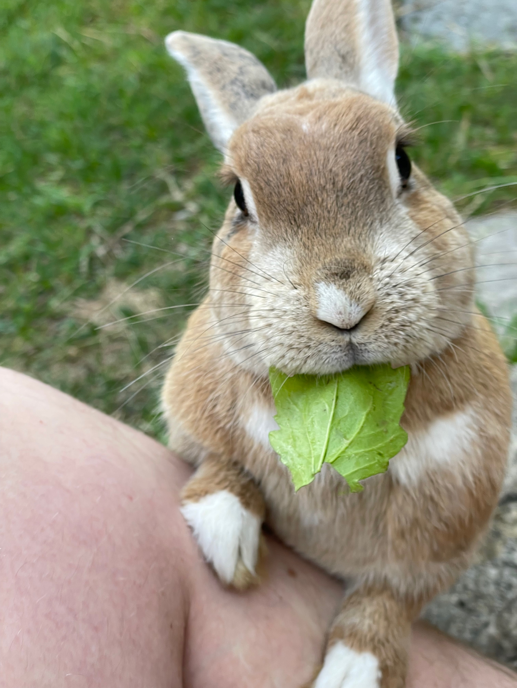
Thank you!
Questions?
Ralph Gasser
ralph.gasser@unibas.ch
Databases and Information Systems (DBIS) Group, Department of Mathematics and Computer Science, University of Basel

Slide 33
Backup Slides (Definitions)

Slide 34
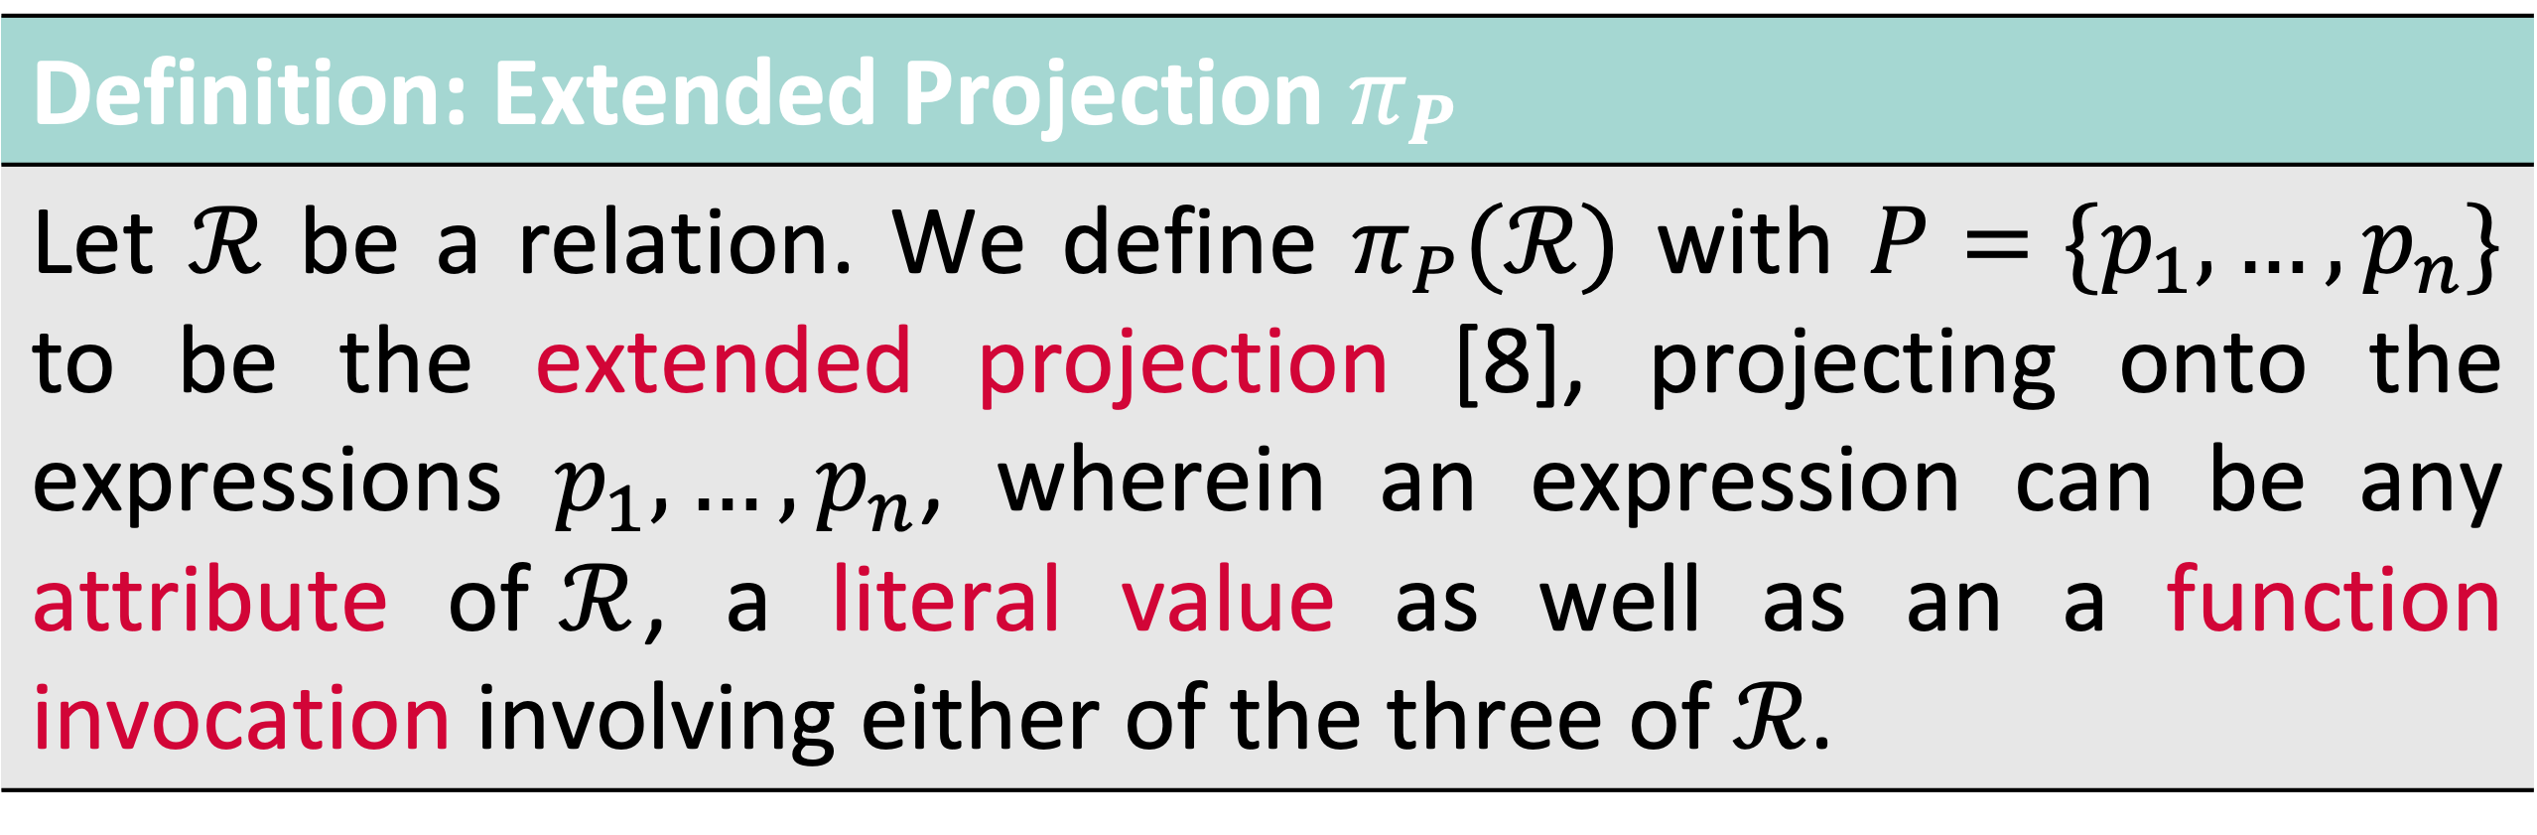
Relational Algebra Extensions Extended Projection
Definition: Extended Projection $π_{P}$
Let $ℛ$ be a relation. We define $π_{P}(ℛ)$ with $P=\{p_{1},…,p_{n}\}$ to be the extended projection [8], projecting onto the expressions $p_{1},…,p_{n}$, wherein an expression can be any attribute of$ℛ$, a literal value as well as an a function invocation involving either of the three of $ℛ$.
Observation #1: Projection may involve evaluation of a distance function → We call this a proximity based query
Observation #2: Domain of a function is an implicit extended projection
→ Functions can be nested

Slide 35
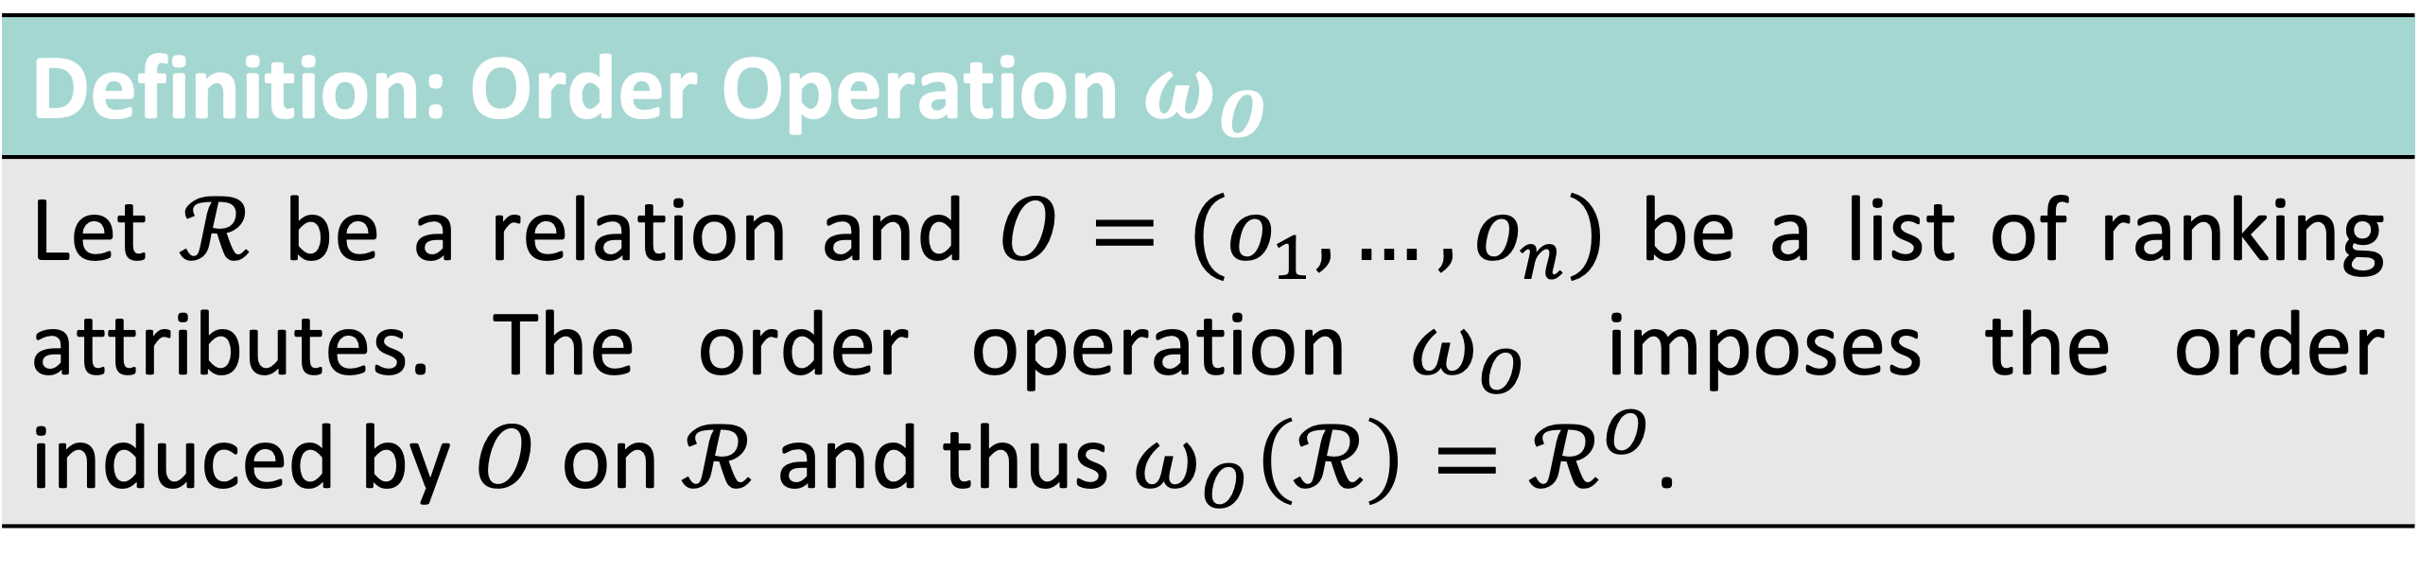
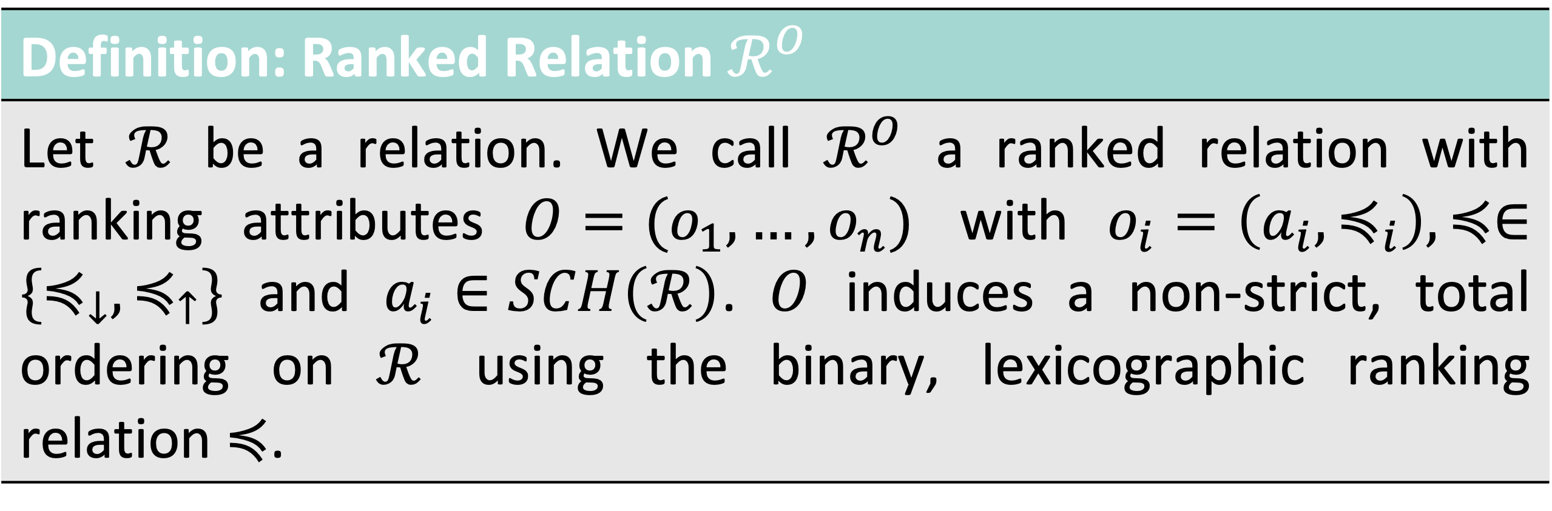
Relational Algebra Extensions Ranked Relations and Order
Definition: Ranked Relation $ℛ^{O}$
Let $ℛ$ be a relation. We call $ℛ^{O}$ a ranked relation with ranking attributes $O=(o_{1},…,o_{n})$ with $o_{i}=\left(a_{i},≼_{i}\right), ≼∈\{≼_{↓},≼_{↑}\}$ and $a_{i}∈SCH\left(ℛ\right)$. $O$ induces a non-strict, total ordering on $ℛ$ using the binary, lexicographic ranking relation $≼$.
Definition: Order Operation $ω_{O}$
Let $ℛ$ be a relation and $O=(o_{1},…,o_{n})$ be a list of ranking attributes. The order operation $ω_{O}$ imposes the order induced by $O$ on $ℛ$ and thus $ω_{O}\left(ℛ\right)=ℛ^{O}$.

Slide 36
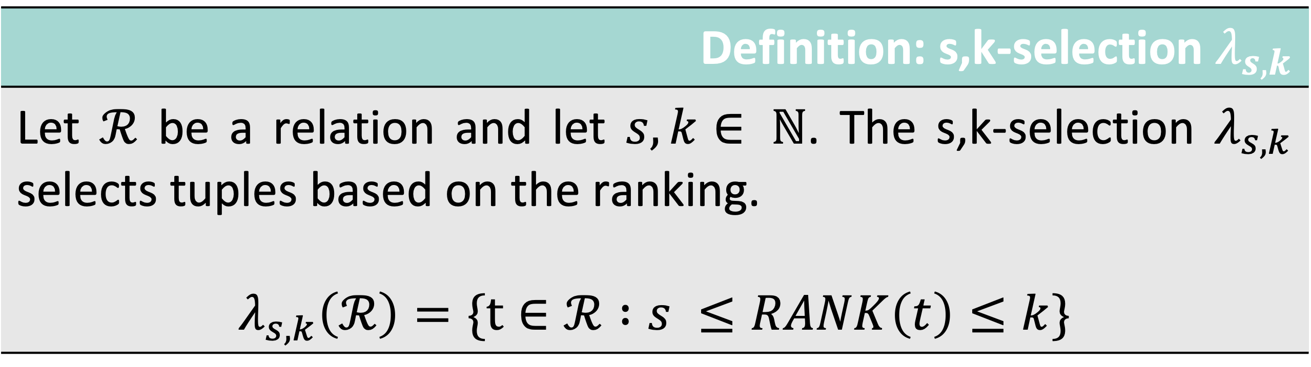
Relational Algebra s,k-selection
Definition: s,k-selection $λ_{s,k}$
Let $ℛ$ be a relation and let $s,k∈ ℕ$. The s,k-selection $λ_{s,k}$ selects tuples based on the ranking. $$λ_{s,k}\left(ℛ\right)=\{t∈ℛ :s ≤RANK\left(t\right)≤k\}$$

Slide 37
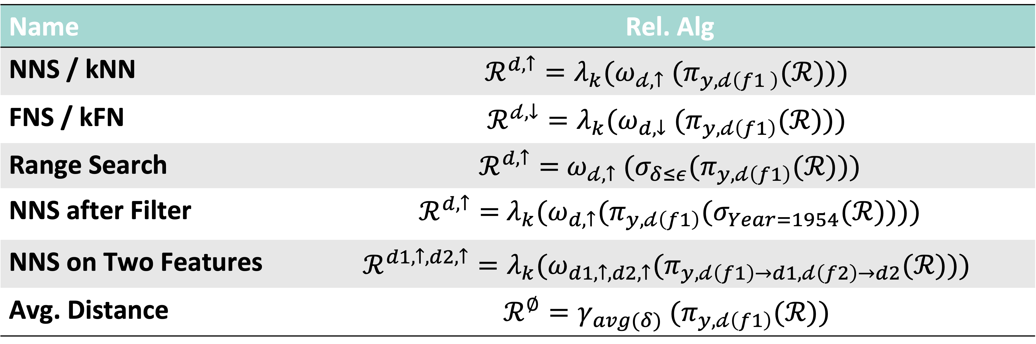
Expressing Proximity Based Queries
Name | Rel. Alg
NNS / kNN | $${ℛ^{d,↑}=λ}_{k}({ω_{𝒹,↑} (π}_{y,𝒹\left(f1 \right)}(ℛ)))$$
FNS / kFN | $$ℛ^{𝒹,↓}=λ_{k}({ω_{d,↓} (π}_{y,𝒹\left(f1\right)}(ℛ)))$$
Range Search | $ℛ^{d,↑}=$ ${ω_{𝒹,↑} (σ_{δ≤ε}(π}_{y,𝒹\left(f1\right)}(ℛ)))$
NNS after Filter | $ℛ^{d,↑}=$ ${{λ_{k}(ω}_{d,↑}(π}_{y,𝒹\left(f1\right)}(σ_{Year=1954}(ℛ))))$
NNS on Two Features | $${ℛ^{d1,↑,d2,↑}={λ_{k}(ω}_{d1,↑,d2,↑}(π}_{y,𝒹\left(f1\right)→d1,𝒹\left(f2\right)→d2}(ℛ)))$$
Avg. Distance | $${{ℛ^{∅}=γ}_{avg(δ)} (π}_{y,𝒹\left(f1\right)}(ℛ))$$

Slide 38
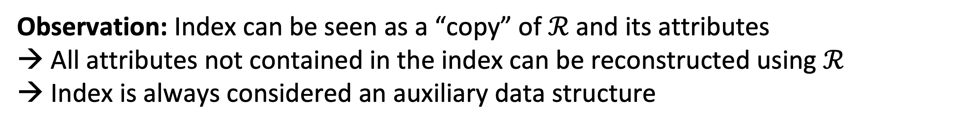
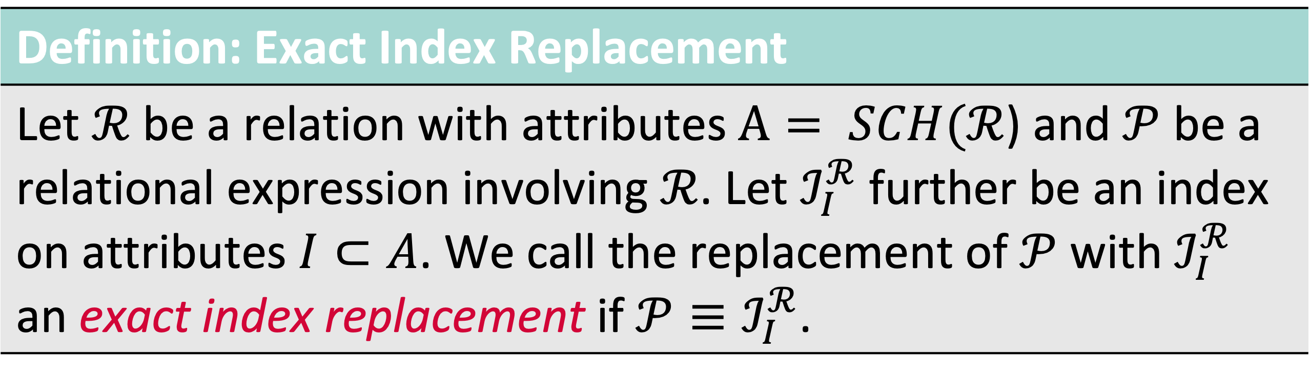
High-Dimensional Indexes and Rel. Alg. Extension
Definition: Exact Index Replacement
Let $ℛ$ be a relation with attributes $A= SCH(ℛ$) and $𝒫$ be a relational expression involving $ℛ$. Let $ℐ_{I}^{ℛ}$ further be an index on attributes $I⊂A$. We call the replacement of $𝒫$ with $ℐ_{I}^{ℛ}$ an exact index replacement if $𝒫≡ℐ_{I}^{ℛ}$.
Observation: Index can be seen as a “copy” of $ℛ$ and its attributes → All attributes not contained in the index can be reconstructed using $ℛ$
→ Index is always considered an auxiliary data structure
$$ℐ_{I}^{ℛ}⋈_{TID}π_{A}\left(ℛ\right), A=\{a:a∈SCH\left(ℛ\right) ∧a∉SCH\left(ℐ_{I}^{ℛ}\right)\}$$
“Fetch”

Slide 39
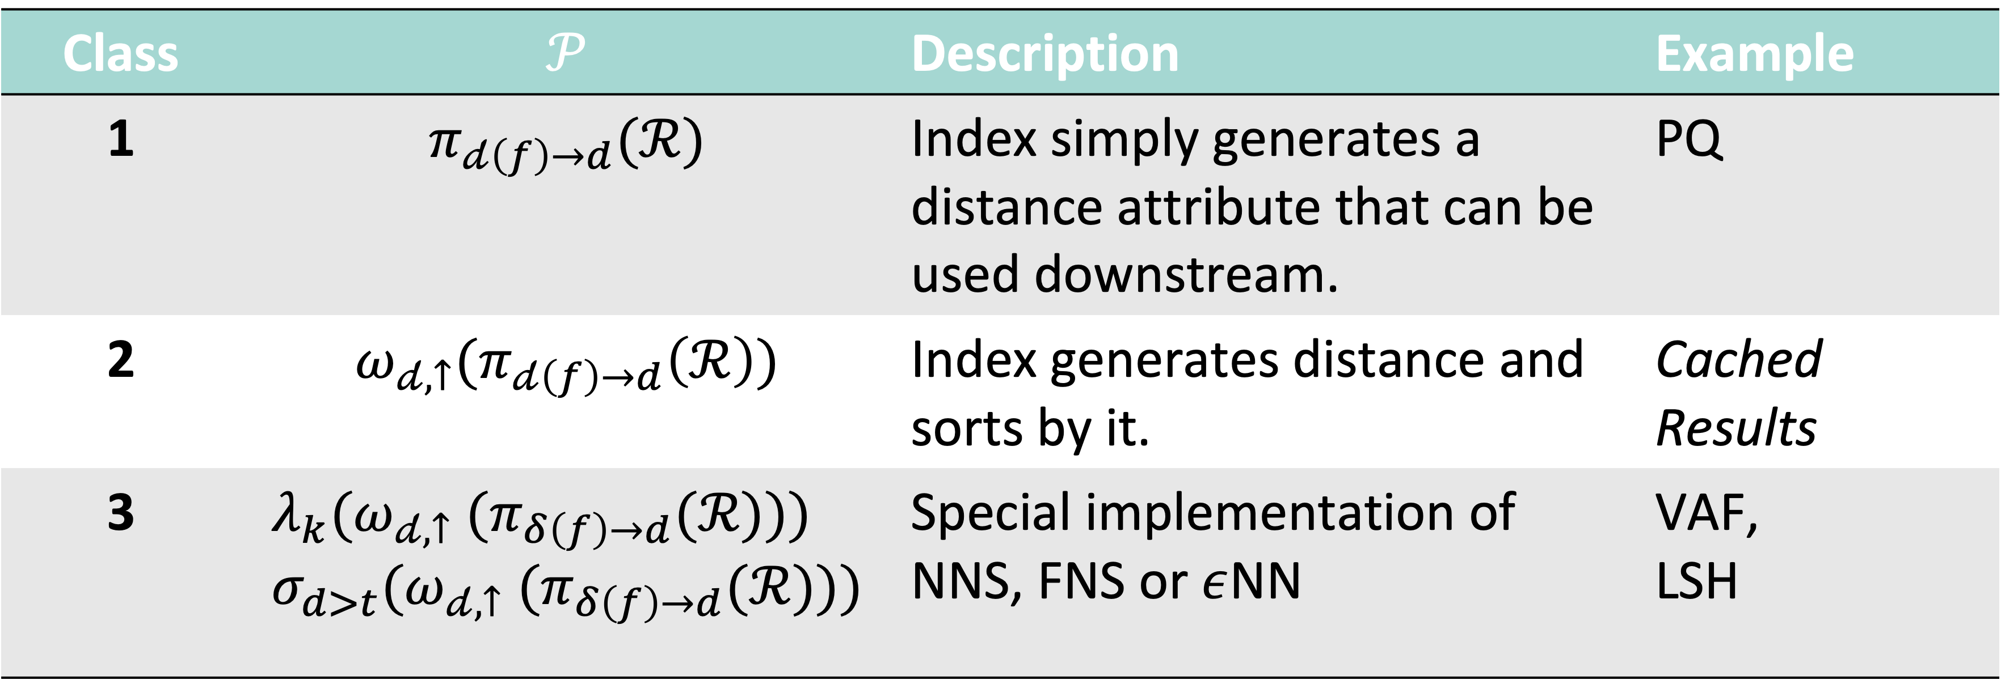
High-Dimensional Indexes and Rel. Alg. Extension
Class | $$𝒫$$ | Description | Example
1 | $$π_{𝒹\left(f\right)→d}(ℛ)$$ | Index simply generates a distance attribute that can be used downstream. | PQ
2 | $$ω_{𝒹,↑}(π_{𝒹\left(f\right)→d}\left(ℛ\right))$$ | Index generates distance and sorts by it. | Cached Results
3 | $$λ_{k}({ω_{𝒹,↑} (π}_{δ\left(f\right)→d}(ℛ))) \\ σ_{d>t}({ω_{𝒹,↑} (π}_{δ\left(f\right)→d}(ℛ)))$$ | Special implementation of NNS, FNS or $ε$NN | VAF, LSH

Slide 40
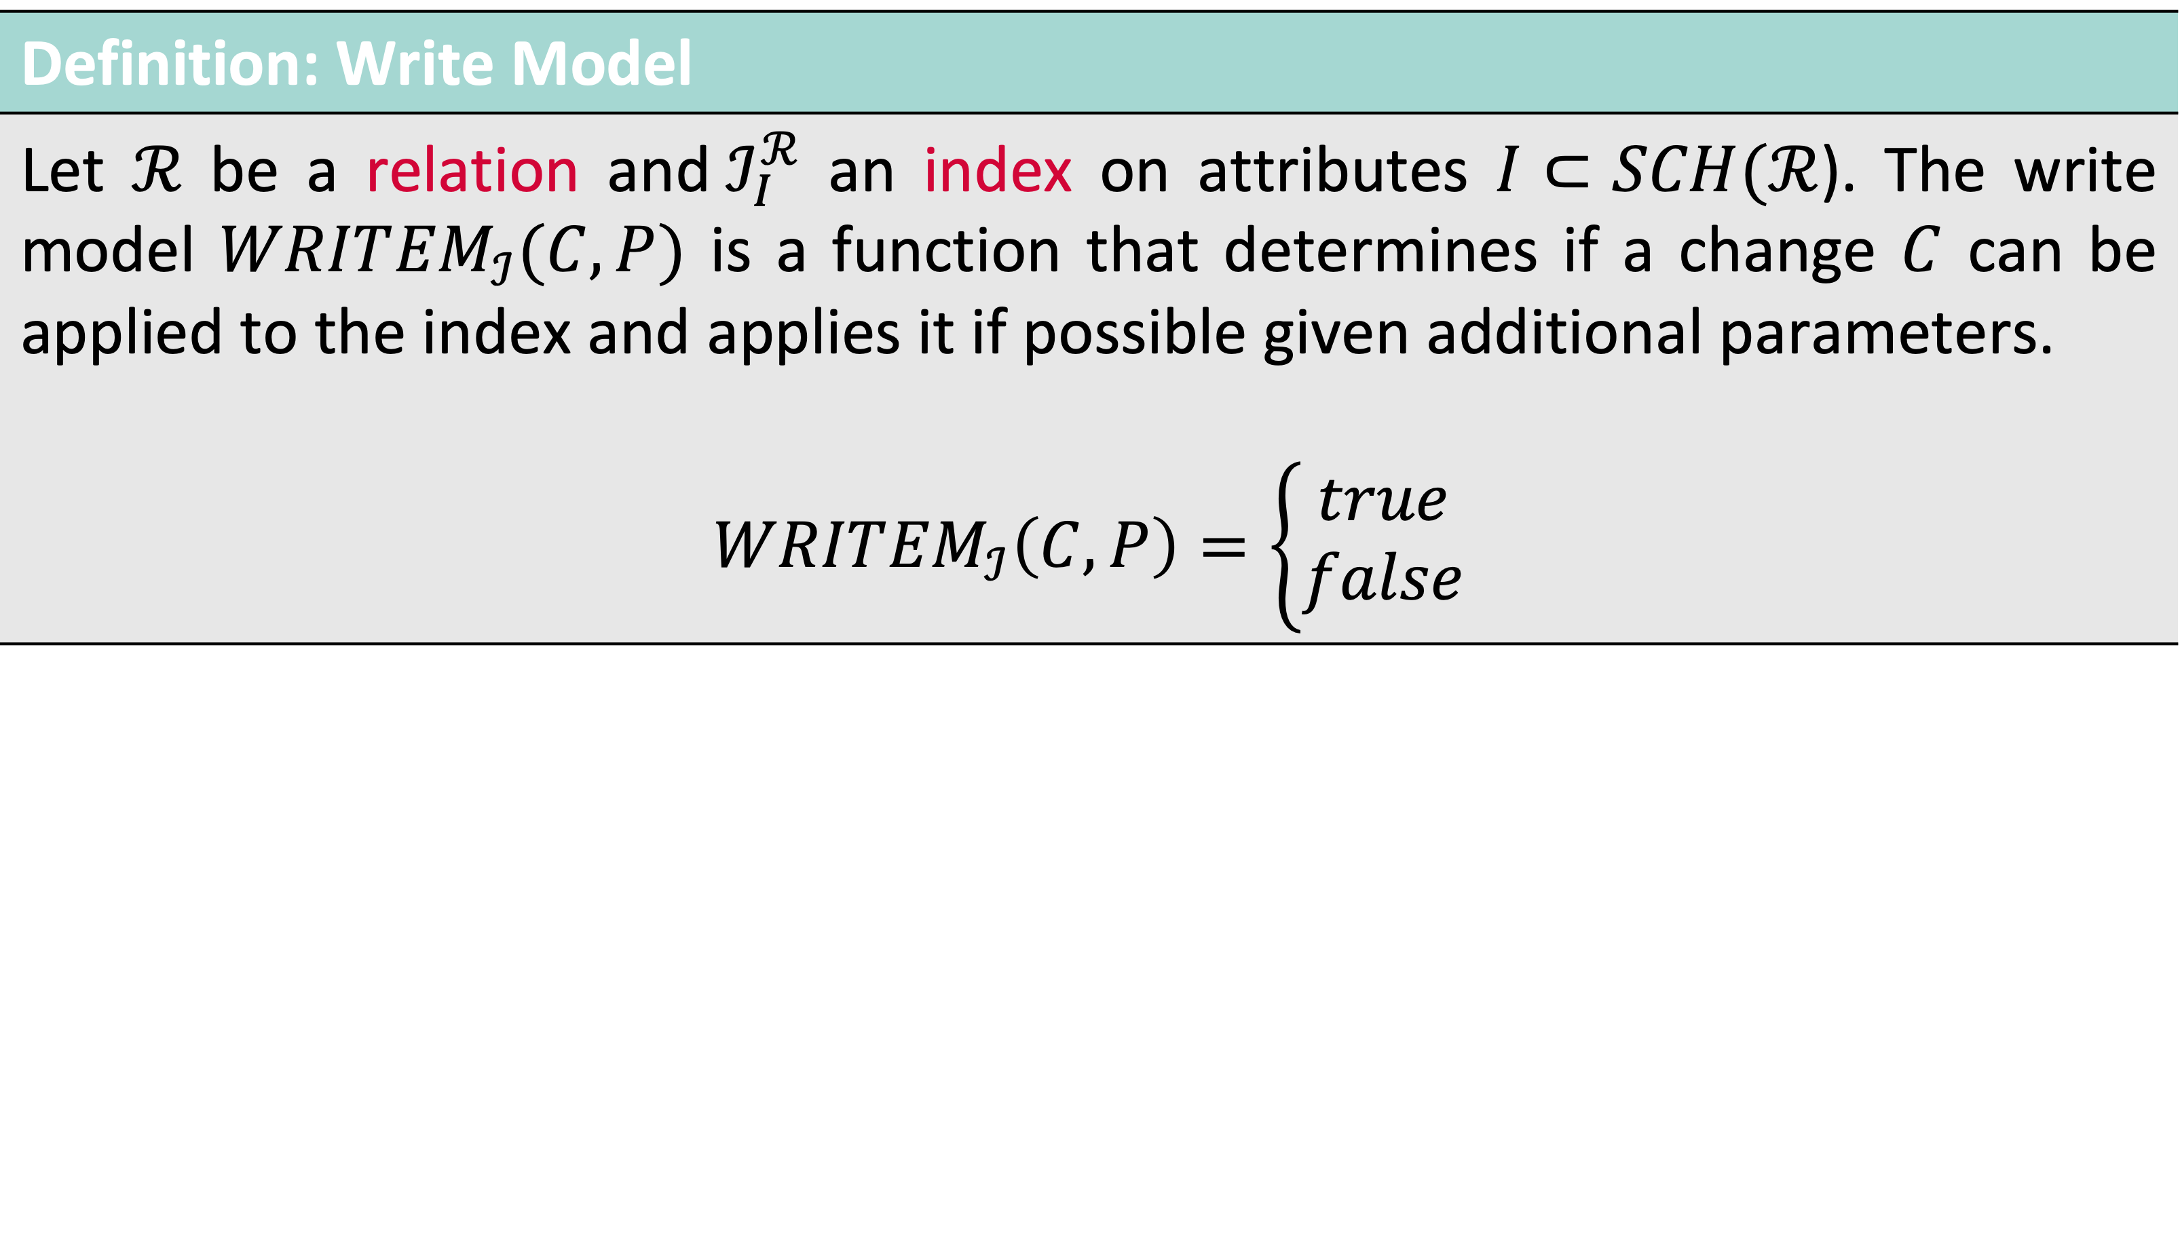
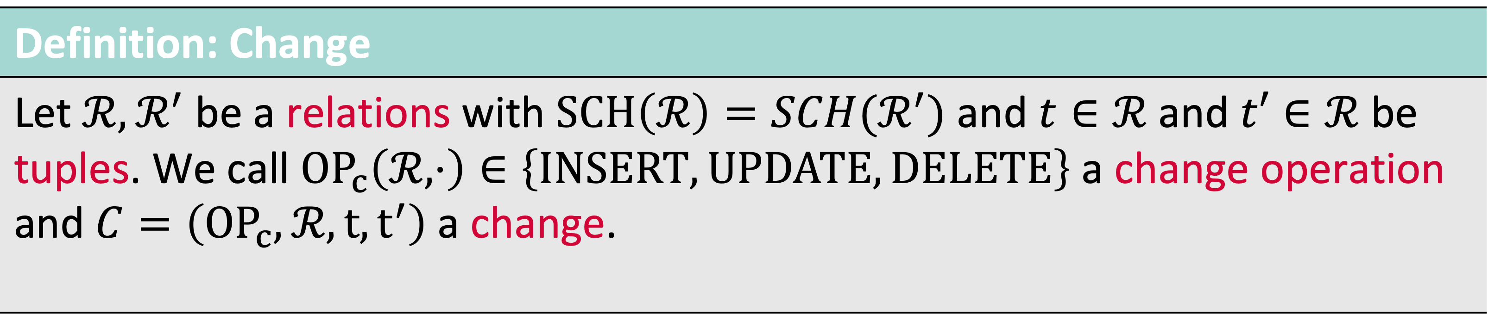
Write Model of an Index
Definition: Change
Let $ℛ,ℛ^{′}$ be a relations with $SCH\left(ℛ\right)=SCH(ℛ^{′})$ and $t∈ℛ$ and $t′∈ℛ$ be tuples. We call ${OP}_{c}\left(ℛ, ⋅\right)∈\left\{INSERT, UPDATE, DELETE\right\}$ a change operation and $C=\left({OP}_{c},ℛ,t,t^{′}\right)$a change.
Definition: Write Model
Let $ℛ$ be a relation and${ ℐ}_{I}^{ℛ}$ an index on attributes $I⊂SCH(ℛ$). The write model $WRIT{EM}_{ℐ}(C,P)$ is a function that determines if a change $C$ can be applied to the index and applies it if possible given additional parameters. $$WRIT{EM}_{ℐ}\left(C,P\right)=\left\{\begin{aligned}true \\ false\end{aligned}\right.$$

Slide 41
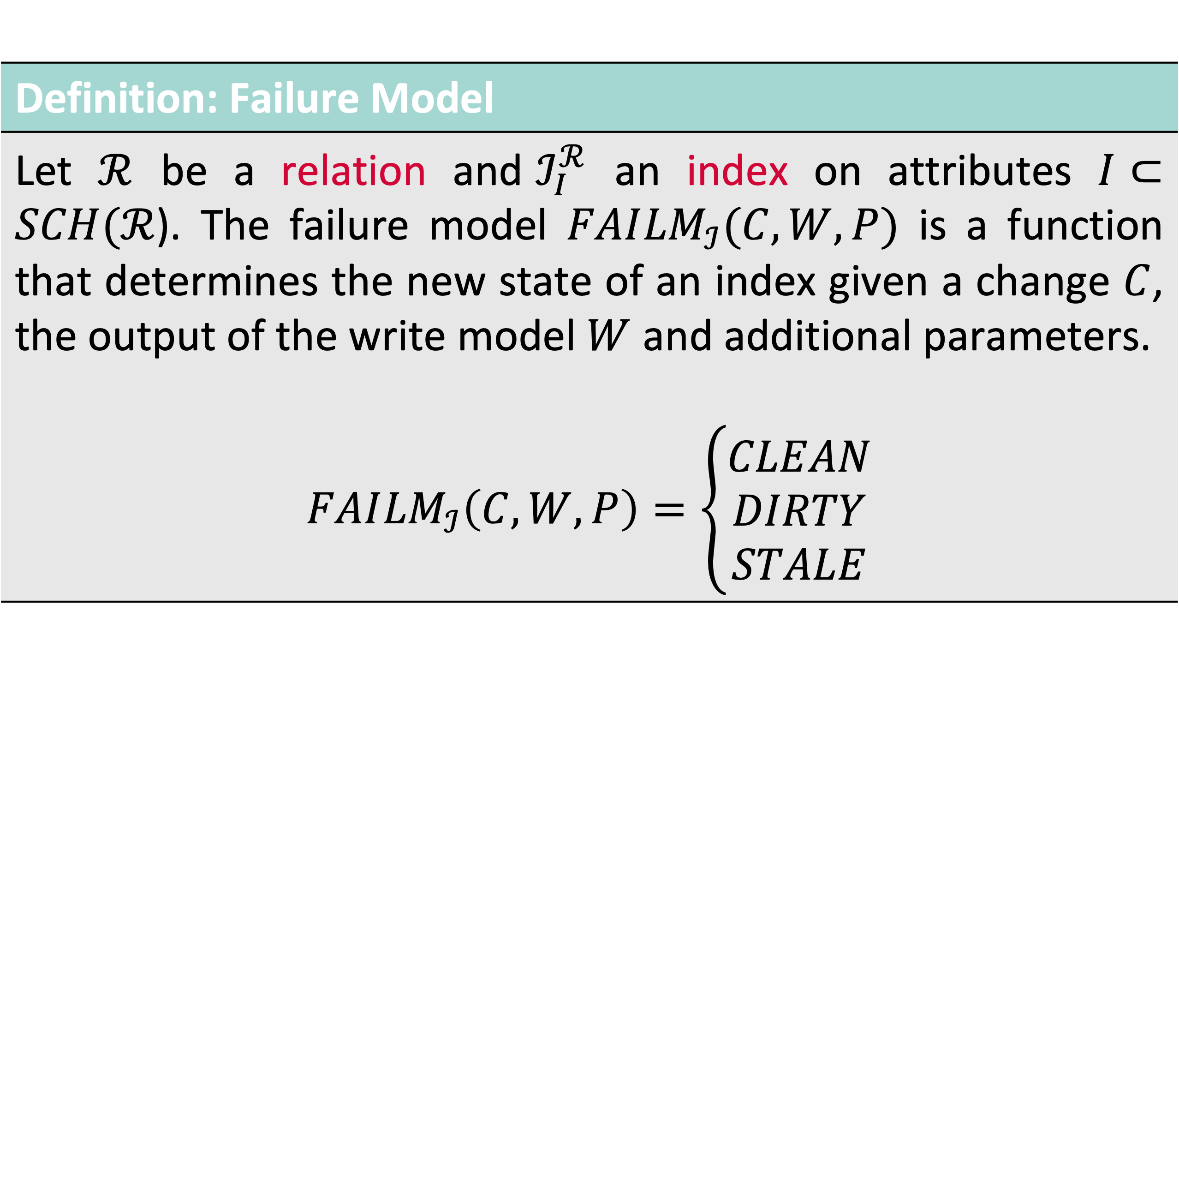
Failure Model and State of an Index
Definition: Failure Model
Let $ℛ$ be a relation and${ ℐ}_{I}^{ℛ}$ an index on attributes $I⊂SCH(ℛ$). The failure model $FAI{LM}_{ℐ}(C,W,P)$ is a function that determines the new state of an index given a change $C$, the output of the write model $W$ and additional parameters. $$FAI{LM}_{ℐ}\left(C,W,P\right)=\left\{\begin{aligned}CLEAN \\ DIRTY \\ STALE\end{aligned}\right.$$

Slide 42
Backup Slides (Evaluation)

Slide 43
Evaluation: Milvus vs. Cottontail DB Results: Cottontail DB

Slide 44
Evaluation: Milvus vs. Cottontail DB Results: Milvus

Slide 45
Evaluation: The Effect of Changing Data Results (VAF Index)
Configuration:
PQ index [1]
Runtime 30min
90% Insert / 10% Delete
No noise
[1] Jégou et al. (2011). Product Quantization for Nearest Neighbor Search.

Slide 46
Evaluation: The Effect of Changing Data Results (VAF Index)
Configuration:
PQ index [1]
Runtime 60min
Index rebuild after 30 min
90% Insert / 10% Delete
Random noise
[1] Jégou et al. (2011). Product Quantization for Nearest Neighbor Search.

Slide 47



Motivation: Working with Multimedia Data Collections (Idealised Case)
Query
Result
“I’m looking for an image of my favourite rabbit.”
User
Multimedia Database
Data Collection

Slide 48


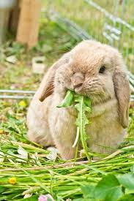
Motivation: Working with Multimedia Data Collections (Actual Case)
Query by Sketch
Query
Result
“I’m looking for an image of my favourite rabbit.”
…
User
Multimedia Database
Data Collection
Exploration

Slide 49

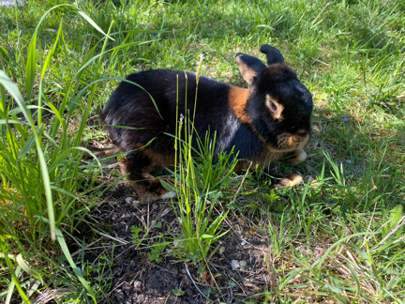
Motivation: Working with Multimedia Data Collections (Actual Case)
Query by Example
Query
Result
“I’m looking for an image of my favourite rabbit.”
…
User
Multimedia Database
Data Collection

Slide 50
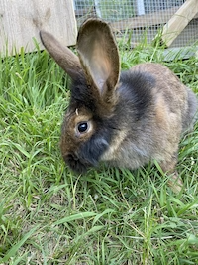
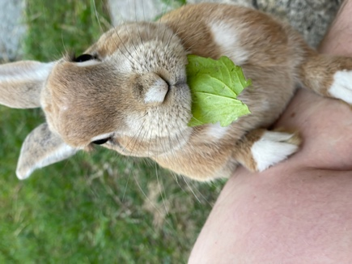


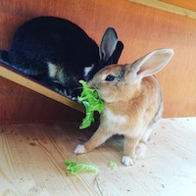
Motivation: Working with Multimedia Data Collections (Actual Case)
Query by Example
Query
Result
“I’m looking for an image of my favourite rabbit.”
…
User
Multimedia Database
Data Collection

